Slide 1
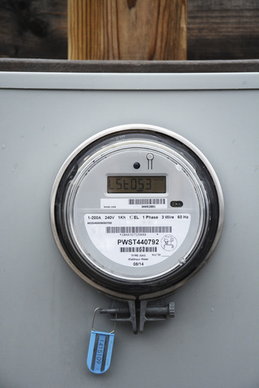

Deloitte response
Consultancy Services for assisting and supporting in Project Management to APDCL for Smart Metering Implementation works under “Revamped Reforms-Linked Results-Based Distribution Sector Scheme”
E-Tender No. APDCL/ CGM (PP&D)/ RDSS/ SMART METERING PMA/ 2022/ 1 DTD. 11.04.2022
Deloitte Touche Tohmatsu India LLP, May 2022

Slide 2
Contents
1
About Deloitte
2
Approach & Methodology
3
PMA Team

Slide 3








With you today…
Anujesh Dwivedi
Partner
Deloitte India
Somsankar Bose
Independent Consultant
Dipak Mukherjee
Independent Consultant
HES Expert
Smart Meter Expert
Present in offline Mode
Vijay Kumar Kalagara
Associate Director
Deloitte India
Sayan Mitra
Associate Director
Deloitte India
Tarun Kumar Sahu
Senior Consultant
Deloitte India
MDM Expert
Team Leader
SI Expert
Rohit Sood
Manager
Deloitte India
Harshita Lal
Assistant Manager
Deloitte India
Cloud Expert
Cyber Security Expert

Slide 4
About Deloitte

Slide 5

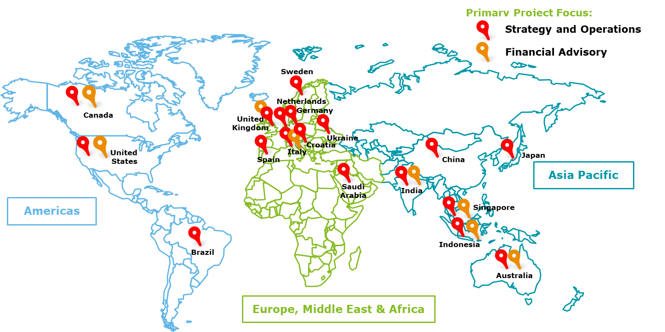
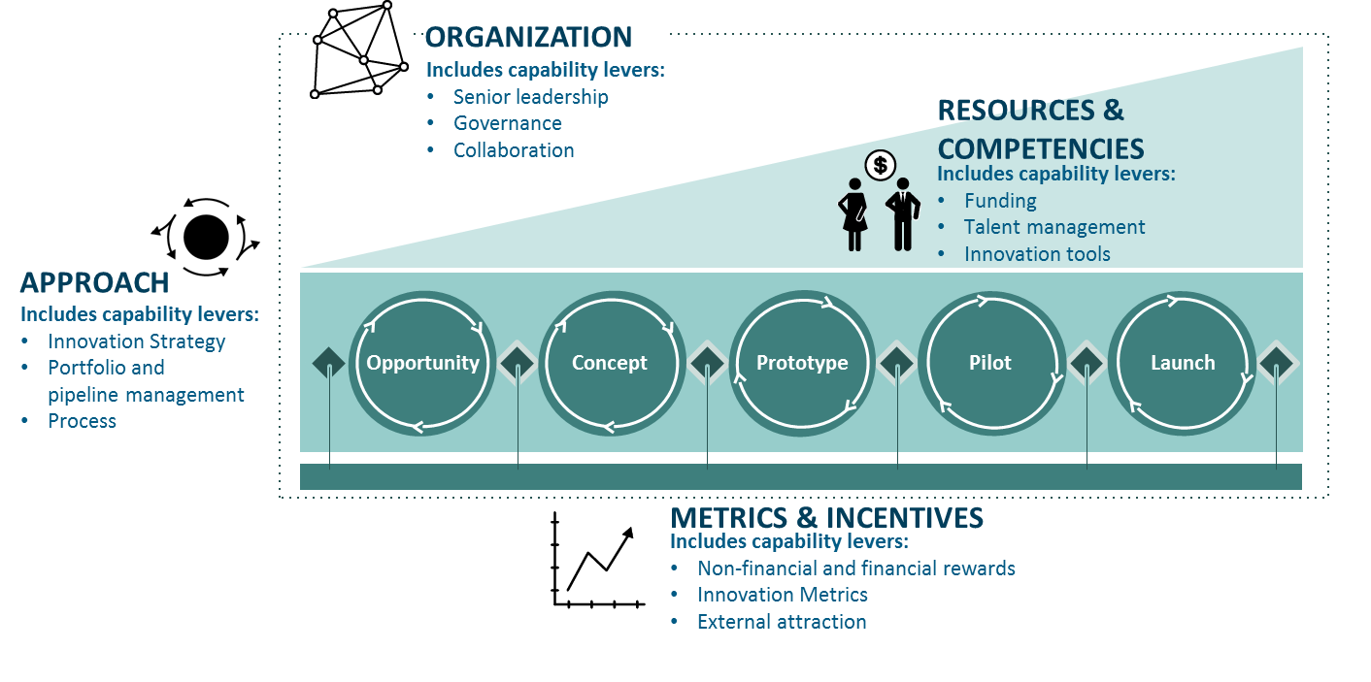
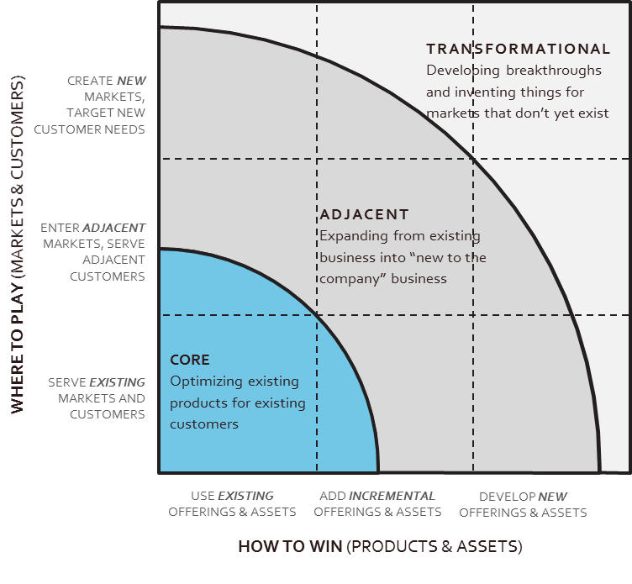
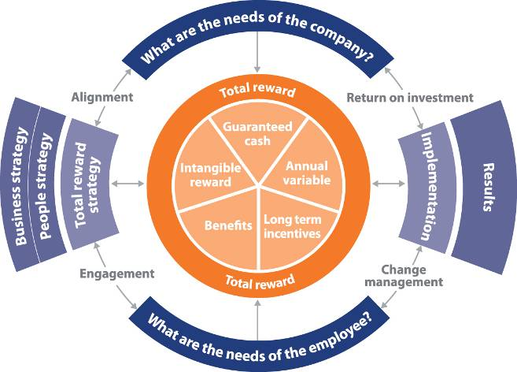



Deloitte brings “best-in-class” capabilities across all aspects of strategy, innovation and market assessment coupled with the experience of partnering with some of the leading clients across the world
#1
#1 in Consulting
Largest services and consulting firm globally with >$20.8 Bn revenue from consulting business
A
Ranked #1 in Organizational Consulting, based on strategy and capability
Deloitte serves 13 of the top 24 power companies and utilities
Licensed databases, Proprietary tools and framework
Strong Power Sector Experience
F
B
Tools & Accelerator
The Deloitte
Difference
Understand Distribution Utilities goals, aspirations and challenges very well
Assisting 20+ DISCOM’s, Regulatory Commissions, MoP, State Power Departments, Bilateral & Multilateral Agencies in multiple engagements
Areas of Support include Project Management, Bid Process Management, Transaction Advisory, Strategy & Business Design, Regulatory Support, Due Diligence, Restructuring & Reorganization among others
Strong association with Indian Power Sector
Dedicated Innovation and Strategy Practice
E
C
C
C
Global innovation firm focused on solving complex problem through a combination of design, strategy, social science and tech.
Strong execution team
Strategy arm of Deloitte consulting, founded by Prof. Michael Porter (Harvard Business School)
D
D
345,000+ professionals
Located in 150+ countries
12,000+ professionals
12 locations

Slide 6






Why should you look at us?
A Firm which.…
Associated with MoP, Nodal Agencies (REC and PFC) in various capacities
Providing Smart Metering bid process management and project execution support in multiple states in India.
Preparation of RFP document for ~1.1 million consumers and AMI project execution for >1 Lakh nodes in J&K.
1
Embedded as Project Monitoring Agency for State utility for Smart Metering & Billing projects
Implementation of 6.5 Lakhs Smart Meters under JPSIP & JSBAY scheme.
Provided consultancy services for setting up a Central Project Monitoring Unit at JBVNL Headquarters which included Learning & Development themes for Employees
2
Expertise in Integration of AMI System
Integration of AMI System with SAP
Implementation of “Pre-Payment Scheme” along with AMI Integration using SAP CD for prepayment.
3
Expertise of working across multiple state in various capacities to monitor & evaluate progress of Smart Metering implementation
Preparation of Action Plan and DPR for HPSEB Ltd. under RDSS scheme
4
Rich and long-standing experience in Distribution Utilities and Metering domain
Support for the Smart Meter Project Component Preparation and Support for the SCADA DPR Preparation for the Energy Reform Programme
5

Slide 7
Team Experience in Providing Similar Consultancy Services…(1/2)
Type of Experience | Client Name | Project Name | Key Points
PMC | JBVNL, Ranchi | PMC support for ICT and OT Implementations | Support for Bid Process Management processes for procurement and implementation of Smart meters in Ranchi
 | Larson and Toubro NDMC, UP and Haryana | Smart meter cyber security assessment for UP, Haryana , NDMC and EESL. | Cyber security assessment for L&T smart metering infrastructure, for over 13.2 Lakh meters for UP, Haryana and NDMC.
 | Bosch | Smart meter security assessment for Bosch Rajasthan region. | Perform cyber security assessment for smart meter Rajasthan. Over 22,000 smart meters installed.
 | POSOCO, Delhi | National Open Access Registry (NOAR) portal UAT | Monitoring and reporting of SI functions
Smart Metering | Bharti Infratel | Consultant to BHARTI INFRATEL in NE Circle | Assist in technology change for Bharti Infratel’s internal billing system, ensuring compliance with Smart Meters.
 | APDCL | Oversaw Smart Grid Pilot Project implementation in Guwahati Zone | Rollout of smart meter, data concentrator unit
MDMS | JBVNL, Ranchi | Technical advisory services for Smart metering implementation in Jharkhand | Prepare solution integration architecture with MBC, MDMS, HES & CIS
 | HPSEBL | Preparation of action plan and DPR under RDSS | DPR and action plan preparation for Smart Metering, HES, MDM and Billing solution
 | CESC Projects Ltd. | Strategy and Operationalization of Distribution Franchisees | smart metering including MDMS and HES integration For city of Kota

Slide 8
Team Experience in Providing Similar Consultancy Services…(2/2)
Type of Experience | Client Name | Project Name | Key Points
Cloud Computation | BOSCH, India | Smart Meter, data on cloud and Cyber security assessment | Creating a customized framework for Bosch-EESL AMI Infrastructure hosted on Azure
 | EESL | Smart Meter Cyber security assessment | Connect AMI with HES, MDMS & Helpdesk, Cloud Infrastructure & Workforce Management
HES | REC Power Distribution Company Ltd. | RECPDCL Bid Process and project execution Support for Smart Metering Implementation | Document covering integration of HES with Oracle MDMS system and other existing IT applications of utility
 | JBVNL, Ranchi | Consultancy services smart metering project in Jharkhand under JPSIP & JSBAY Scheme | Preparation of technical specifications for design of HES, Network management system in line with CEA guidelines
Cyber Security | Larsen & Turbo | Smart Meter Cyber security assessment | Creating a customized framework for EESL AMI Infrastructure hosted on cloud
 | EESL | Smart Meter Cyber security assessment | EESL AMI security audit, review policies and procedures as per OWASP, ISO/IEC 27001:2013, Data Privacy, NIST Cybersecurity Framework
SI | Himurja (Himachal Pradesh) & GIZ | Development of a Single Window Clearance Web Tool & Potential improvement Program Himachal Pradesh | Integration done with MBC ,SPIN Portal (MNRE),Payment ,Email & SMS Gateway

Slide 9
Approach & Methodology

Slide 10
Task 1: Bid Process Management
Task-1
Key Aspects to be considered in Bidding Documents
Most common challenges in Defining Scope for Smart Meter Data Integrations
Definition of Scope of Work and Deliverables with high project plan
Definition of performance parameters and SLAs to be met by the vendor
Define bidding parameters like Mode of Bidding, Procurement Methods, Evaluation Criteria
Data Quality – IT/OT/ET Devices to use the appropriate and validated data
Multiple Interface – Numerous interfaces with systems exchanging data in different formats
Preparation of bidding documents and bid process management
Review of technical specifications and suggest improvements
Preparation of Bidding Documents
Support APDCL in Bid Process Management
Evaluation of proposals and preparation of bid evaluation reports
Assist APDCL in Contract of Award
Technical Specification of smart meter, communication technology and system requirement
Definition of performance parameters and SLAs to be met by the vendor
Define Staged Delivery schedule and payment terms
Security – Strict Adherence to security governance policies
Business Process Change – Streamline & Improve operational efficiencies
General and Special Terms and Conditions governing the RFP
Nature of system documentation required and training schedule
Post Implementation support requirements
Communication – Robust Communication Infrastructure to address the huge volume of field & data transfers
Deloitte was engaged with RECPDCL to provide bid process management for smart metering implementation
Deloitte prepared RFP document for ~1.1 million consumers and AMI project execution for >1 Lakh nodes in J&K

Slide 11


Task 2: Project Management
Providing Smart Metering bid process management and project execution support in multiple states in India.
Task-2
Deloitte’s SMART Project Management Office (PMO) helps maintain control while executing large capital projects through a holistic framework enabled by technology, process & people alignment
Providing Smart Metering bid process management and project execution support in multiple states in India.
Deloitte’s SMART PMO Framework
Digital PMO Enablers
Technology
Integrated Project Monitoring and Control
Integrated project management
Collaboration Management
Risk Management
Schedule Analytics
Change Management
Business BI Platform
Web/Mobile Based Dashboard
Working as consultants with Department of Power , West Bengal, monitoring progress of Smart Metering in state
Working as consultants with Department of Power , West Bengal, monitoring progress of Smart Metering in state
Project Management of the implementation of smart metering infrastructure
Assist APDCL in pre-implementation activities
Supervision of implementation activities
Support in preparing MIS for project activities
Support in execution of system handover
Commercial, revenue and regulatory management support
SMART PMO
People
Process
Integrated MIS reports
Automated dashboard on Metering-Billing-Collection
PMU CELL ILLUSTRATIVE STRUCTURE
(Comprising of key Officials from APDCL
and other key stakeholders)
PROJECT SCHEDULES & CHARTS
Increasing decision making authority
Digital control over activities
Maintaining timelines
Coordination & MIS Support
APEX LEVEL COMMITTEE
PROJECT IMPLEMENTATION CONSULTANTS
(PIC)
Consultancy Services Smart metering Project in Jharkhand under JPSIP in Ranchi, Dhanbad & Jamshedpur for ~6.5 lac consumers
DIGITISED FINANCIAL CONTROL
TECHNICAL TASK FORCE/WORKING GROUP
FINANCIAL TASK FORCE/ WORKING GROUP
SAFEGUARD TASK FORCE/ WORKING GROUP
Financial projections
Sensitivity Analysis
Efficiency of management of capital projects gets enhanced through integrated & collaborative project management platforms supplemented by digital point solutions

Slide 12
PMA Team

Slide 13













Our Proposed Team (1/2)
Our team poised to deliver value to APDCL
Our Proposed Team | Years of Experience | Key Areas of Expertise | Countries of Work Experience | Clients
Sayan Mitra Team Leader | 18+ | Smart Meter data management, MDMS implementation, IT Landscape Rationalization, | India (Odisha, Meghalaya, Assam, WB, UP, Manipur, Gujrat), US clients from Offshore
Vijay Kumar Kalagara MDM Expert | 21+ | Implemented CIS/CRM and MDM products, IT PMO- Bid Process Management, ICT projects, IT Consulting | India, USA, Afghanistan, Kyrgyzstan, Rwanda, Saudi Arabia, Thailand
Dipak Mukherjee Smart Metering Expert | 35+ | Implemented Smart Grid Pilot project, meter testing, Strategic Integration panning, MIS reporting, Heading task force against meter theft, Transmission line management. | India (Northeast Region including Assam)

Slide 14














Our Proposed Team (2/2)
Our team poised to deliver value to APDCL
Our Proposed Team | Years of Experience | Key Areas of Expertise | Countries of Work Experience | Clients
Somsankar Bose HES Expert | 38+ | Architecture design for AMI including MDMS and HES, vendor selection, technology selection, Business Intelligence | India, Nepal, Ghana, Nigeria, RMI, Bangladesh, FSM
Tarun Kumar Sahu SI Expert | 8+ | Preparation of Analytics Roadmap, Program Management, Develop Smart online prepaid metering, | India (Jharkhand, Delhi, Rajasthan, HP, Odisha, MP, Maharashtra) Nepal
Rohit Sood Cloud Expert | 12+ | IT Infrastructure, PMS support, Program Management, IT Cost Rationalization, Cloud Management and Implementation | India
Harshita Lal Cyber Security Expert | 5+ | AMI security audit, NIST Cybersecurity Framework, AMI system Integrator, Smart Meter Cyber Security Expert | India (Delhi, Haryana, Uttar Pradesh)

Slide 15
Deloitte refers to one or more of Deloitte Touche Tohmatsu Limited (“DTTL”), its global network of member firms, and their related entities (collectively, the “Deloitte organization”). DTTL (also referred to as “Deloitte Global”) and each of its member firms and related entities are legally separate and independent entities, which cannot obligate or bind each other in respect of third parties. DTTL and each DTTL member firm and related entity is liable only for its own acts and omissions, and not those of each other. DTTL does not provide services to clients. Please see www.deloitte.com/about to learn more.
© 2022. For information, contact Deloitte Touche Tohmatsu Limited.

Slide 16
Appendix

Slide 17
Why Smart Meter

Slide 18
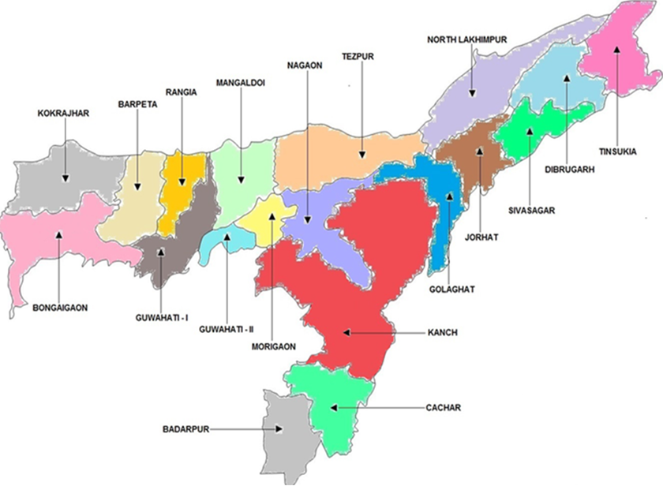
Brief Profile of APDCL
Division-wise Billing and Collection Efficiency in Assam
97%
Billing Efficiency
94%
100%
84%
Below 80%
101%
84%
80-90%
103%
75%
Above 90%
99%
100%
82%
83%
78%
99%
Collection Efficiency
77%
Below 95%
95-99%
88%
100% and above
84%
91%
98%
Basic details w.r.t APDCL*
84%
Total Number of Consumers : 64 Lakhs
Total MU Sold : 7108 MU (FY 19-20)
Total Prepaid Meter : 5513 Nos.
Administrative Structure : 3 Regions, 8 Zones, 19 Circles, 45 Divisions, 158 Sub-divisions
84%
97%
100%
81%
75%
95%
97%
93%
Note: Overall performance in terms of Billing Efficiency and Collection Efficiency has been good for Assam, with special emphasis to divisions like Guwahati I and II, however there is still significant scope for improvement where smart metering heavily comes into play
104%
87%
77%
103%
74%
101%
93%
81%
77%
102%
94%
*Source: APDCL website; Details as on 01st May 2021

Slide 19
Smart Meter Implementation for APDCL
Assam is amongst the front-runners in terms of firming up their proposals under the RDSS Scheme
Reduce Losses and improve operational efficiencies
Benefits of Smart Metering
4
Empowers customer
2
Disconnection & reconnection
Remote disconnection to help in faster recovery of dues
More customer control over electricity consumption, costs, and bills
Facilitates greater use of new customer tools (e.g., web portals and smart electrical devices)
Remote re-connection will help in short turn around time for reconnection after dues are paid
D
C
B
A
Reduces provisional billing and increases estimation accuracy and precision significantly
Help vigilance team take informed decision on loss prevention drives
Remote meter reading using AMI generates more timely, accurate bills
Identify areas/DTR with high losses
Remote Meter reading
3
Reduction in theft of Power
1

Slide 20
Impact of Smart Metering in Assam
Real-time Information
Real-time billing information allows utilities to implement dynamic pricing and demand response programs.
Increased System Awareness
Instant detection of outage or a fault. Through regular flow of information, utilities can make informed decisions better
Cost savings
This allows optimum allocation of human resources.
Further, this helps improving Billing efficiency and overall AT&C losses, thus reducing the ACS-ARR gap
Advantages of smart metering
Reduction in overall power purchase cost for APDCL
Scenario Analysis to illustrate net probable savings by APDCL
Rationale for power purchase cost reduction:
Smart Metering would aid in improving billing efficiency
Hence, for same quantum of energy sold, net input energy requirement would decrease, and would keep on decreasing with subsequent further improvement of billing efficiency
Thus, the requirement to purchase that additional quantum of power for DISCOM in case of lower billing efficiency would considerably decrease
Particulars |  | Billing Efficiency | Energy Sold (MU) | Net Input Energy (MU) | Net Energy Reduction (MU) | Average Power Purchase Cost of APDCL | Net Saving | Saving in Per Unit
 |  | (%) |  |  |  | ( Rs /KWh) | ( Crore) | (Rs/KWh)
Actual Parameter* |  | 81% | 7457.83 | 9156 | 0 | 4.28* | 0
Phase Wise Reduction
Phase Wise Reduction
Phase Wise Loss Reduction Planning | Phase 1 | 82% | 7457.83 | 9095 | 61 |  | 26 | 0.03
 | Phase 2 | 85% | 7457.83 | 8774 | 321 |  | 137 | 0.16
 | Phase 3 | 88% | 7457.83 | 8456 | 318 |  | 136 | 0.16
 | Phase 4 | 91% | 7457.83 | 8155 | 300 |  | 129 | 0.16
 | Phase 5 | 95% | 7457.83 | 7850 | 305 |  | 130 | 0.17
*Source: AERC Tariff Order (March 2022) for Petition No. 12/2021

Slide 21

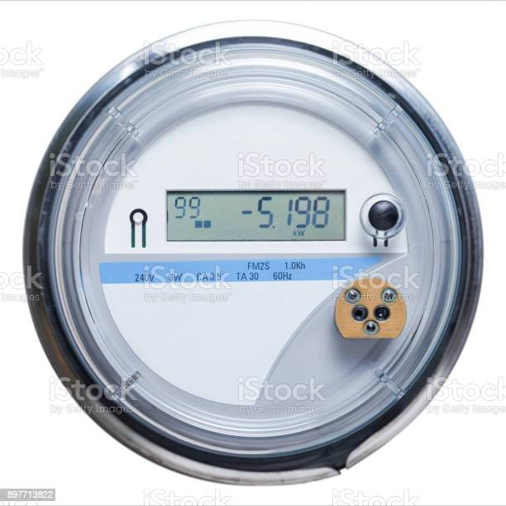

Reference Smart Meter Architecture
Zone 1
Zone 3
Zone 4
Zone 5
Zone 2
Zone 3
Zone 2
Dis-comm and Legacy systems
Smart Meter Network
Pictures
Head end system
Billing systems
GPRS Connectivity
RF Mesh
PLC
Mobile applications
Connectivity
API
API
API
Web Self service (consumer portal)
Middleware
MDM
Middleware
CRM and meter data syncs
Web services
Web services
Web services
ERP
Unauthorized meter authentications
Malicious Firmware Update
Insecure Firmware update transfers
No integrity checks on firmware files
Meter tampering and cyber physical attacks
Meter memory DDOS attacks
Connectivity issues
Meter Coning
SIM Cloning
Remote Connectivity
Unauthorized Bulk Commands, remote connect and disconnect
No MPLS Firewall
Errors in manual batch processing of smart meter files
Insecure API’s
No integrity checks on meter data files
Insecure smart meter gateways and integrations
Privacy threats for consumer sensitive data
Unauthorized consumer energy consumption pattern analysis.
Unencrypted network
Dependencies on Discoms for CRM data.
APT threats from mobile system.
Modifications in billing process data.
Sensors and Actuators
IP Communication
Supervisory and control systems
Operations Management
CRM

Slide 22
Smart Meter

Slide 23
Smart Meter – Key Considerations and requirements
Key Technical Considerations
Minimum requirements/guidelines for adherence
Setting Meter Rating specifications in line with standards
Instantaneous parameters of meter should be aligned to HES such that data is sent to HES at predefined intervals
Meter should be able to communicate with Data Centers using pluggable and interchangeable NIC* (RF Mesh/4G/PLC)
Setting requirements to ensure interoperability of any upgrade in Hardware and Software without any cost during warranty and post warranty period
OTA (Wireless) update of meter should be possible
Meter should be equipped with third party communication module that should have suitable hand-shaking features to allow a third-party MDMS (procured by APDCL) to configure, command, read and control smart meters installed at site
# | Standards / Aspect to be considered | Detail
1 | Functional Requirements of Advanced Metering Infrastructure (AMI) In India | Minimum functionalities with performance for AMI system proposed to be developed
2 | Technical Specifications of Single & three phase whole current Smart Meter | Single phase and three phase smart meter specification based on relevant Indian standards.
3 | Guidelines for communication system of smart meters PLC, RF, cellular network (3G/4G) | Feasibility and benefits of each technology in Indian standards for Smart metering
4 | IS 16444:2015 (Part 1) | Standard for Static watt-hour direct connected smart meters
5 | IS 16444:2017 (Part 2) | Standard for Transformer operated static watt-hour smart meters
6 | IS 15959:2016 (Part 2) | Standard for Data Exchange for electricity smart meters
7 | IS 15959:2017 (Part 3) | Standard for Data Exchange for electricity smart meters (Transformer Operated)
Other Key Considerations
Proper Sealing w.r.t Terminal block of meter: This needs to be done to avoid sparking/formation of carbon/exposure to moisture possibly resulting in short circuits. This is further necessary at the outset, since periodic visits for meter reading won’t take place
Smart Push Notification system to restrict possible Energy Theft: Automatic notification to utility if supply is not restored by consumers (through bill payment) within 3 days of disconnection. This is based on the logic that probability of power theft would be highest among consumers who don’t reconnect their connection post disconnection due to non-payment of bill
Consumer Awareness: Making consumers aware on how to make payments directly through the portal. Further, post disconnection (if any), important to raise consumer awareness regarding immediate resumption of services post successful payment
Communication: Appropriate contingency for loss of communication due to failure of RF mesh or GPRS
*Network Interface Card – device to connect to network

Slide 24
Interoperability of the Smart Meter system
We will consider the interoperability of the smart meters of different makes and models with IT system so that in future when APDCL shall scale up the AMI system the interoperability can be achieved.
There are two ways to make the system interoperable i.e.
The data coming from meter end are in a common format or
To deploy a mechanism at server end so that the data from different meters can be stored in a common database system.
Flexibility to adept
The standard must be designed to adopt to the continuously evolving requirement specification of the meters regardless of the requirements specific to the customer, utility or country
Existing Installed Base of Meters
Portability to application software
The interoperability standard should be designed such that existing installed base electronic meters can be read and integrated into the application
The standard should be that it cab be easily ported into the existing (and yet to be developed) application software for billing, revenue protection, load and engineering analysis
Interoperability of Meters
Hardware limitation
Communication Protocol
The solution should be hardware independent so that it could provide backward and forward compatibility
Keeping rapid changes in meter protocol as per the requirement, the solution should be independent of communication protocol
Efficiency and Comprehensiveness
Speed and accuracy are outmost important in communication standard to make interoperable these factors ignored
Indian Standards (BIS and any other agency defining standards)
CEA functional Guidelines
APDCL Specific Requirement

Slide 25
HES

Slide 26

HES and AMI Technology: Software Solutions; Vendor Landscape and Integration Issues
Head End System:
HES is responsible for,
Meter data acquisition and converting data into output file for MDM system in required formats
Communication between utility command center and end devices.
Multiple communication techniques are permissible for two-way communication between control center and end device like RF, GPRS, PLC etc . Based on that following variants of HES are deployed
Unified HES – compatible with all communication techniques
Standalone HES – compatible for a particular communication techniques
Proprietary or vendor specific protocols widely used for data transmission over the air. This is enabler of using multiple HESs.
HES / MDAS
Automatic polling / On Demand reads
Two-way communication establishment
Remote Disconnect / Reconnect
Data encryption for communication
RTC time synchronization
Data retention
Control signals / Event messages handling & logging
Smart meter configuration support
Communication device status and history logging
Network information logging
Critical and non-critical reporting
MDMS
Automatic polling / On Demand reads
Meter asset management
Meter installation support
Meter data management
Data Validation, Estimation, and Editing (VEE)
Billing determinants calculations
Exception management
Service order management
Customer service support
Data analysis & reporting
Revenue protection support
Demand control / Demand Response Support
Prepayment functionality
Net metering integration
Other business system integrations
Enterprise Applications
Billing / CIS
CRM
GIS
ERP
OMS
DMS
WMS
Customer Portal
Etc.
Smart Meters
End to End and secure integration of HES/MDAS & MDMS is critical for successful AMI implementation

Slide 27
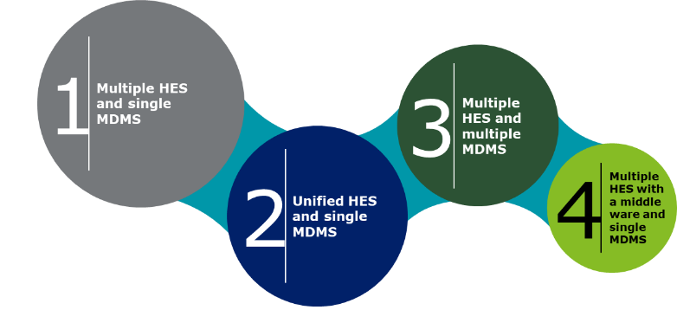
Indicative MDMS and HES selection approach
Key parameters to be considered before selection of HES and MDMS
Integration capability
Implementation time
Fare competition / Vendor availability
Cost
System performance
Data security
Future scalability
Possible Model | Integration capability | Implementation time | Vendor availability | System performance | Data security | Future scalability
Unified HES & single MDMS | Poor | Moderate | Limited | Moderate | High | Good
Unified HES & multiple MDMS | Good | Less (Good) | More | High | Moderate | Fair
Multiple HES & multiple MDMS | Good | Less (Good) | More | High | Less | Less
Multiple HES & single MDMS with middle ware | Best | Least (Best) | Limited | Moderate | Less | Fair

Slide 28
System Integration

Slide 29
System integration Approach
As-IS study of Study of protocols, devices, IT/OT landscape in APDCL
Adopt best practices followed by other utilities
Benchmark performances and suggest possible areas of improvement
Standardize implementation approach of engagement
Ensure the overall system reaches a robust and maintainable state
Approach for Integration
Key Considerations
Integration Challenges
Proper detailing out of System Integration in technical requirements of the bidding document
Integration of HES with MDMS (standard product; should support all standard integration methods)
MDM integration with other systems on standard interfaces and the data exchange models is preferred.
Proposed smart metering program should be compatible with the SAP implementation at APDCL and enable seamless data transfer with SAP ISU software
Data Quality - IT/OT devices to use the appropriate and validated data
Multiple Interfaces - Numerous interfaces with systems exchanging data in different formats
Security - Strict Adherence to security governance policies
Business Process Change - Streamline & improve operational efficiencies
Communication - Robust communication infrastructure to address huge volumes of field data transfer

Slide 30
Meter Data Management System

Slide 31
Meter data Management System
MDM in RDSS
100% Consumer metering (including agricultural) through prepaid or smart prepaid mode
Prepaid smart meter tenders initiated after 1st January 2020 in TOTEX mode eligible for funding
100% communicable DT & Feeder Metering with AMI to enable energy accounting
Metering of unmetered feeders and making all feeder meters (new and old) online
Replacing current non-communicable DT meters with communicable AMI integrated meters
Replacement or fresh DT meter installation in TOTEX mode
Key Functions of MDM in AMI
Enable all the Smart grid initiatives by managing voluminous data of Usage and Events.
Validate Meter reads and events data to provide accuracy. Improve Validation and Estimation using various techniques and algorithms.
Synchronize the Master data and the reading data between the source and Downstream applications and majorly the billing system.
Be the base to implement various applications such as Demand Response, Energy Audit and pre-paid system.

Slide 32
MDM Implementation and Operational Challenges
Implementation
Operation
Multiple Formats of input data
Multiple Formats of input data from meters and HES makes system complex
Standardization of input data is critical to implementation.
Multiple MDM systems
Multiple MDM systems will make integration and Implementation and Synchronizing data between Meters/HES and Billing System complex
High degree of Customization
Higher degree of customization in COTS MDM product hinder patch and version upgrade release by OEM in future dates post implementation
Infrastructure sizing
Volume of data and Infrastructure size need to be accurately assessed
Assessment one based on number of registers being maintained by HES, and MDM.
Prepaid module in MDMS
Prepaid engine in MDMS need continuous integration with meters
Pre-paid module should always be in sync with the financial information and billing system
Communication issues
HESs and Billing System may often communication issues due to Deadlocks and stuck queues in middleware (SOA/MDB etc.)

Slide 33
Cloud

Slide 34
Key Success factors for adopting Cloud
Successful implementation and adoption of the Cloud for APDCL will requires some fundamental risks which need to be addressed for its smooth adoption
Risk Dimension
Mitigation Steps
Success Factors
Inappropriate Infrastructure Selection
Choosing right Location, Region and Availability Zone to minimize network latency
Choosing the correct Size workload (type & size) and associated storage type from the available options
Selection of the correct Location, Region and Availability zone
Correct sizing of the underlying infrastructure components
Fully equipped
Infrastructure resiliency
For Local redundancy, all application components and their associated storages and databases should be deployed in High Availability
For Site redundancy, multiple Availability Zones (Public Cloud) and Disaster Recovery (Private Cloud) should be configured
Building of High Availability and Resiliency at Cloud region (Public), DR (Private) physical hardware and at service
Security Controls
Setting up Network Access Control Lists & Web Application Firewall (WAF) to secure the deployed Application server and Database Datastore in cloud
Creation of segments/designated zones within the Public Cloud or Private Cloud to restrict the traffic within the zone and outside of zones
Use of IAM policies to restrict and govern the Authentication, Authorization and Accounting of access rights
Use of Public Cloud built-in security services and other 3rd party services in accordance with security best practices from Industry
Data Storage and Security Breaches
Reducing the cloud storage cost by building in data archiving e.g., using low performance, high-capacity media in public Cloud
Encryption should be activated to mitigate risk in case of data loss, and to meet specific regulatory requirements with i.e., Encryption at Rest and Encryption in Transit
Secure by Design engrained and security controls
State of continuous compliance achieved through customer owned & managed private key
Service SLA
Appropriate metrics and parameters must be enforced on the cloud providers e.g., Uptime Guarantees, SLA penalties, SLA penalty exclusion, Data Protection, Disaster recovery, Security and privacy, and most important ‘Exit Strategy’ with expectations on the provider to ensure a smooth transition
Tightly coupled SLAs with associated services been offered and availed through CSP

Slide 35
Cloud Data Centers
Cloud Service Provider | Data Center Location for Public Cloud and VPC
Amazon Internet Services Pvt. Limited | Mumbai -03
Bharat Sanchar Nigam Limited (BSNL) | Ahmedabad -01 Faridabad-01
CtrlS Data Centers Limited | Hyderabad-01 Navi Mumbai -01
Cyfuture India Private Limited | Noida- 01 Jaipur-01
ESDS Software solution Pvt. Limited | Nashik-01 Mumbai-01 Bengaluru-01
Google Cloud India Pvt Ltd | Mumbai-01
IBM India Private Limited | Chennai-01
ITI Limited | Bengaluru-01
Microsoft Corporation (India) Private Limited | Chennai-01 Mumbai-01 Pune -01
Netmagic IT Services Private Limited | Mumbai-02 Bengaluru -02
Nxtra Data Limited | Bengaluru-01 Noida- 01
Oracle India Pvt. Ltd | Navi Mumbai-01 Hyderabad-01
Pi Datacenters Pvt. Ltd. | Guntur -01
RailTel Corporation of India Limited | Gurugram-01 Secunderabad-01
Reliance Corporate IT Park Limited | Mumbai-01 Jamnagar-01
Sify Technologies Limited | Bengaluru- 01 Navi Mumbai-01
Tata Communications Limited | Bengaluru-01 Mumbai -01 New Delhi-01
Webwerks India Pvt. Limited | Mumbai -01 Pune-01
New Delhi
Gurugram
Noida
Faridabad
Jaipur
Jamnagar
Nashik
Ahmedabad
Mumbai
Navi Mumbai
Pune
Secunderabad
Hyderabad
Guntur
Bangaluru
Chennai
Meity Empaneled DC Location

Slide 36
Cyber Security

Slide 37
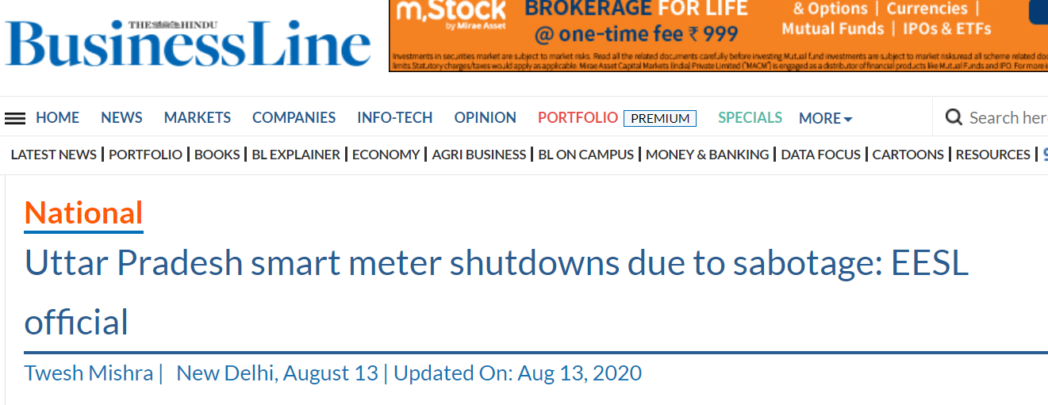
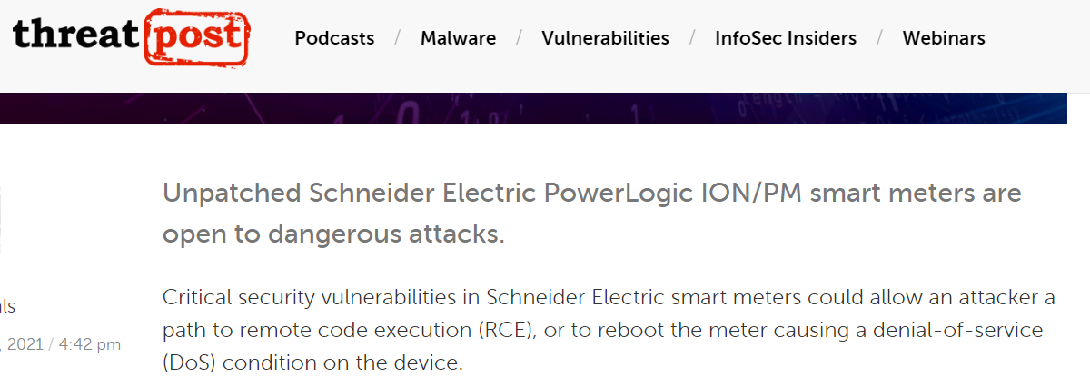
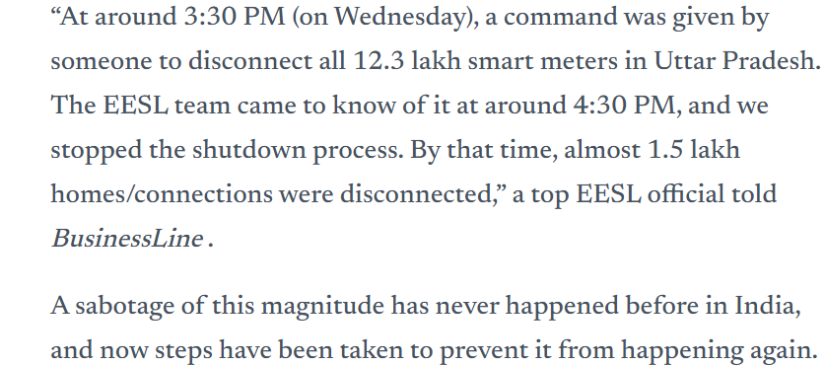
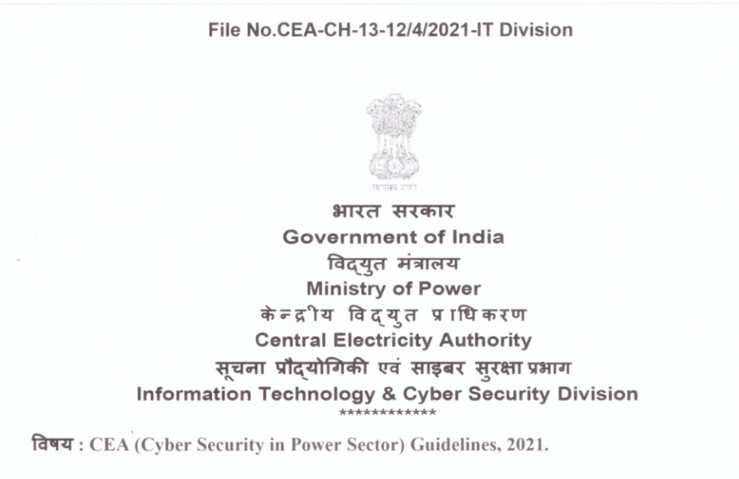
Need of Cyber Security in Utility
Cyber Attacks on smart meters
Legal and regulatory

Slide 38
Cyber Security Use Case
Various Cyber security threats and attacks scenarios for smart meter solution deployments.
Threats to system level security
Theft or theft via services
Threats to privacy
Radio or subversion takeover
Network barge-in by unknown
Cloning or copying
Interception/Eavesdropping
Forward Point Compromise
Credential Compromised
Denial of Service attack & DDOS
Meter Module Intrusion
Backhaul IP network Interception
Misuse of private data
Availability compromises at back office
Radio Jamming
Routing attack
Radio Jabbering
Stack, smashing
Location Migration
Backhaul: Connectivity of internet portals directly with MDM.
Electricity consumption analysis for thefts.
Attacks on Networks
Attacks on Physical Hardware
Attacks on Data
Spoofing
attacks
Killer Bee and ZigBee Attacks
Black Hole attacks
Smart meter physical attacks
Unauthorized Commands sent via vendors
Non-unique meter authentication keys
Data Integrity
Parallel Checksum and Computation
Malicious Software
Insecure smart meter gateways
Network Traffic sniffing
TCP/IP attacks
Battery removal
Services activated on SIM
Non-unique meter identification keys
Checksum forgery attack
Unauthorized access
Parallel Checksum computation attack
Rainbow and Interference attacks
Gray Hole and sybil attacks
Wireless network attacks
Tampering of meter memory
Internet in SIM
Insecure APN
Unauthorized meter commands sent in Bulk
Man in the middle attacks
Eavesdropping of messages sent by smart meter.

Slide 39
Case Study

Slide 40
Deloitte Transforms Jemena into a Data-Driven, Customer Centric Organisation
Video Link

